Slide 1



DEPARTMENT OF ELECTRONICS AND COMMUNICATION ENGINEERING
MINOR PROJECT-IV
FINAL REVIEW [05.04.2024]
AUTOMATIC RAILWAY GATE CONTROL
BATCH NO:14
PRESENTED BY: GUIDE:
K.NAVEENA [927621BEC136] Mrs.P.SANMUGAVALLI
G.PAVIPRAVEENA [927621BEC142] Assistant Proffessor/ECE
S.SARANYA [927621BEC186]

Slide 2
Contents
Introduction
Problem Statement
Objective
Components Required
Circuit Diagram
Working Principle
Existing Methods
Advantages and Disadvantages
Applications
References

Slide 3
Introduction
Railways being one of the safest and cheapest modes of transportation that are preferred over all the opposite means of transport. So, it is essential to take care of and improve the level of safety at railway track and level crossings. Rate of railway accidents at level crossings is high due to manual operation.
Railway gates are manually opened and closed by gatekeeper. To avoid human intervention at crossroads completely, we need to automate the method of railway gate control. Automation basically means to devise a method to reduce or eliminate human efforts or intervention.
This project represents a unique and economical method for improving the security of our crossing road accidents at railway.

Slide 4
Problem Statement
Accidents at the level crossings and on rail tracks are increasing day by day.
The main reason behind it is the careless operation of human workers , lack of resources and lack of technology.
The main purpose of designing the model of this system is to provide automatic control railway gates at level crossings replacing human interference.
This project deals with one of the efficient method to avoid train accidents.

Slide 5
Objective
The main aim of this project is to automize the unmanned railway gate.
The gate is closed automatically whenever the train comes and is opened after the train leaves the railway-road crossing.
It is highly economical Arduino based arrangement, designed for use in almost all the unmanned level crossings in the country.
It is also help by improving safety at railway crossings by reducing the risk of accidents caused by human unconsciousness.

Slide 6
Components Required
Arduino UNO
Infrared Sensors
Servo motor
Bread board
Jumper wires

Slide 7
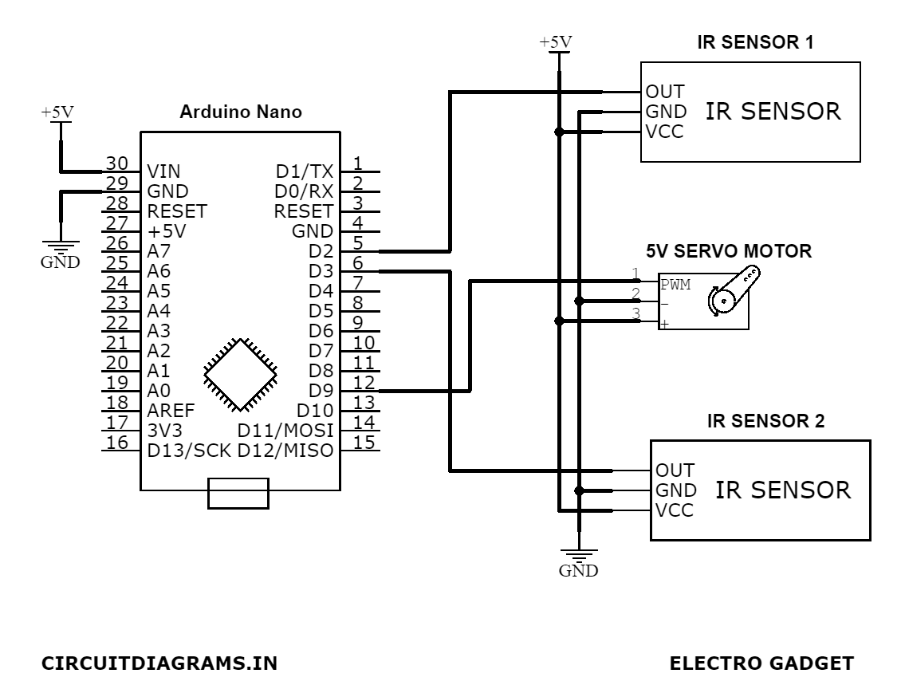
Circuit Diagram

Slide 8
Working Principle
The arrival of train is detected by the Infrared sensors which is placed on the two sides of the gate.
The signals from the sensors are processed by a control unit ,which analyzes the data to determine if a train is approaching the railway crossing.
Based on the information received from the sensors and other inputs, the control unit makes a decision whether to activate the gate control mechanism.
If the control unit determines that a train is approaching, it activates the gate control mechanism to close the railway gates. Once the gates are closed and secured, the train passes through the railway crossing safely.
After the train has passed and it is safe to do so, the control unit activates the gate control mechanism to open the railway gates, allowing vehicles and pedestrians to cross the tracks.

Slide 9
Existing Method
By the presently existing system once the train leaves the station, the stationmaster informs the gatekeeper about the arrival of the train through the telephone. Once the gatekeeper receives the information, they closes the gate depending on the timing at which the train arrives.
Sensor based systems – Ultrasonic sensors ,Pressure sensors ,Acoustic sensors.
GPS based Systems and Timer based systems.
Hybrid system-It combines the sensor based detection method and GPS based method to realize the arrival of train.

Slide 10
Advantages
Prevention of Accidents inside the gate
24/7 operation
Low power consumption
Automatic operation
High Performance and Accuracy
Reduce the man power
Provides safety

Slide 11
Disadvantages
To establish a entire network it is quite costly.
The Arduino UNO board is the delicate device so it has to be handled carefully.
Automatic gate control systems require regular maintenance to ensure proper functioning.

Slide 12
Applications
Railway crossings
Level crossings
Parking gate control
Toll gates
School and College junctions

Slide 13
References
Ajay.V. Deshmukh, Microcontrollers (Theory and Application), Tata McGraw-Hill Publication.
Ahmed Salih Mahdi, Al-Zuhairi, Automatic Railway Gate and Crossing Control based Sensors & Microcontroller, International Journal of Computer Trends and Technology (IJCTT).
https://www.researchgate.net/publication/285604396_Automated_Railway_Gate_Controlling_System [accessed Mar 19 2020].
Chetana Tukkoji, Mahidhar R, Mahesh Krishna V, Shashank D, Vedanth S,” Prevention of Accidents using Automated Railway Crossing System”, International Journal of Engineering and Advanced Technology (IJEAT) ISSN: 2249-8958 (Online), Volume-9 Issue-3, February 2020.

Slide 14
THANK YOU

